Slide 1
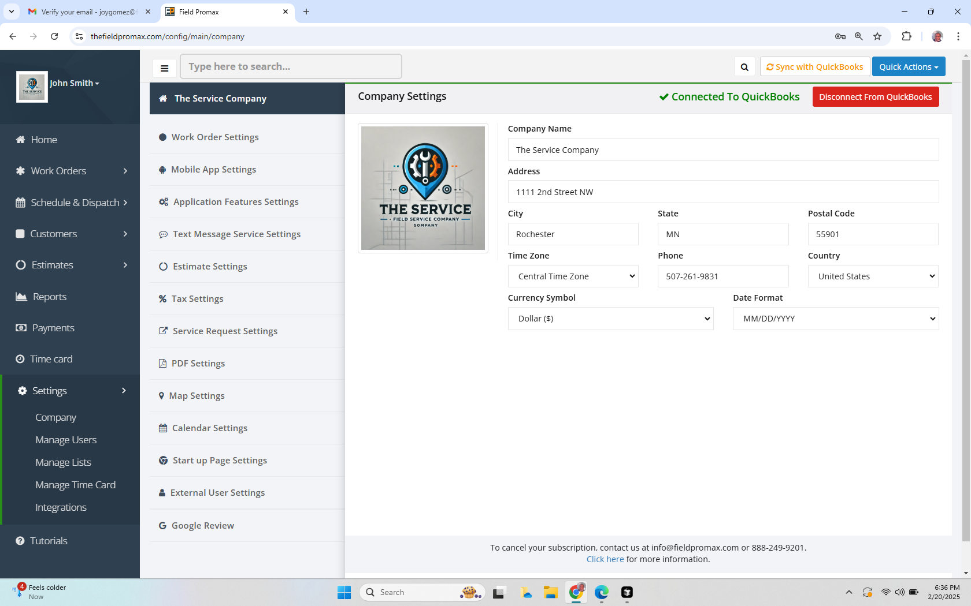
Company settings

Slide 2
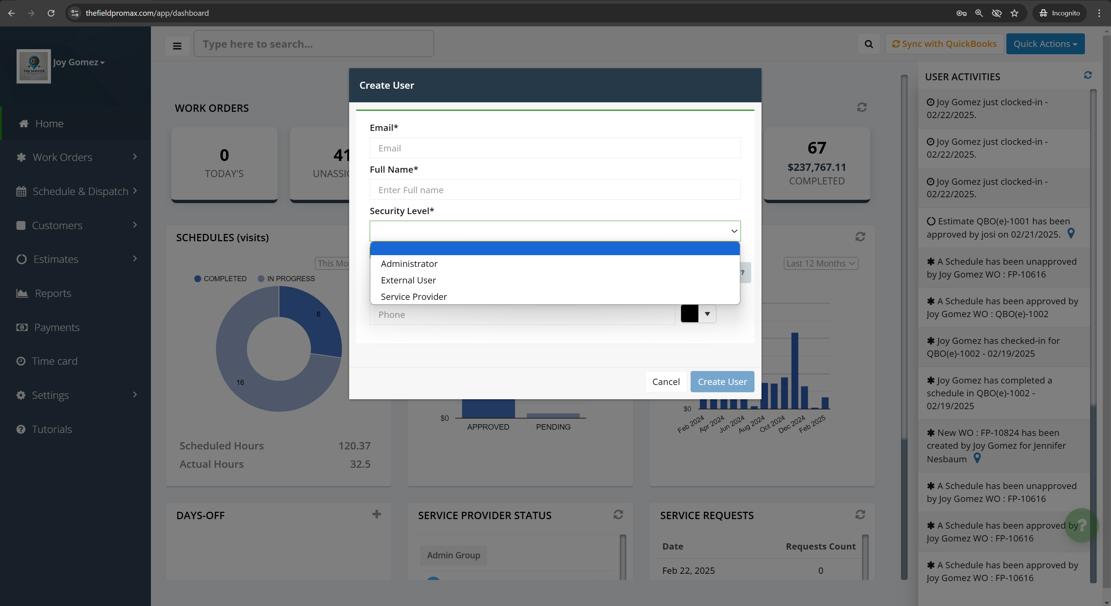
Manage Users

Slide 3
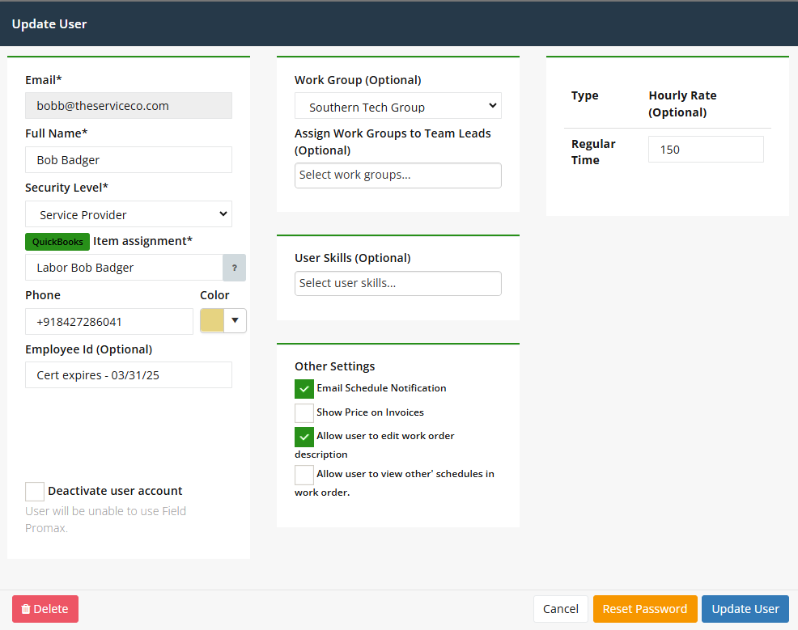
Manage Users

Slide 4
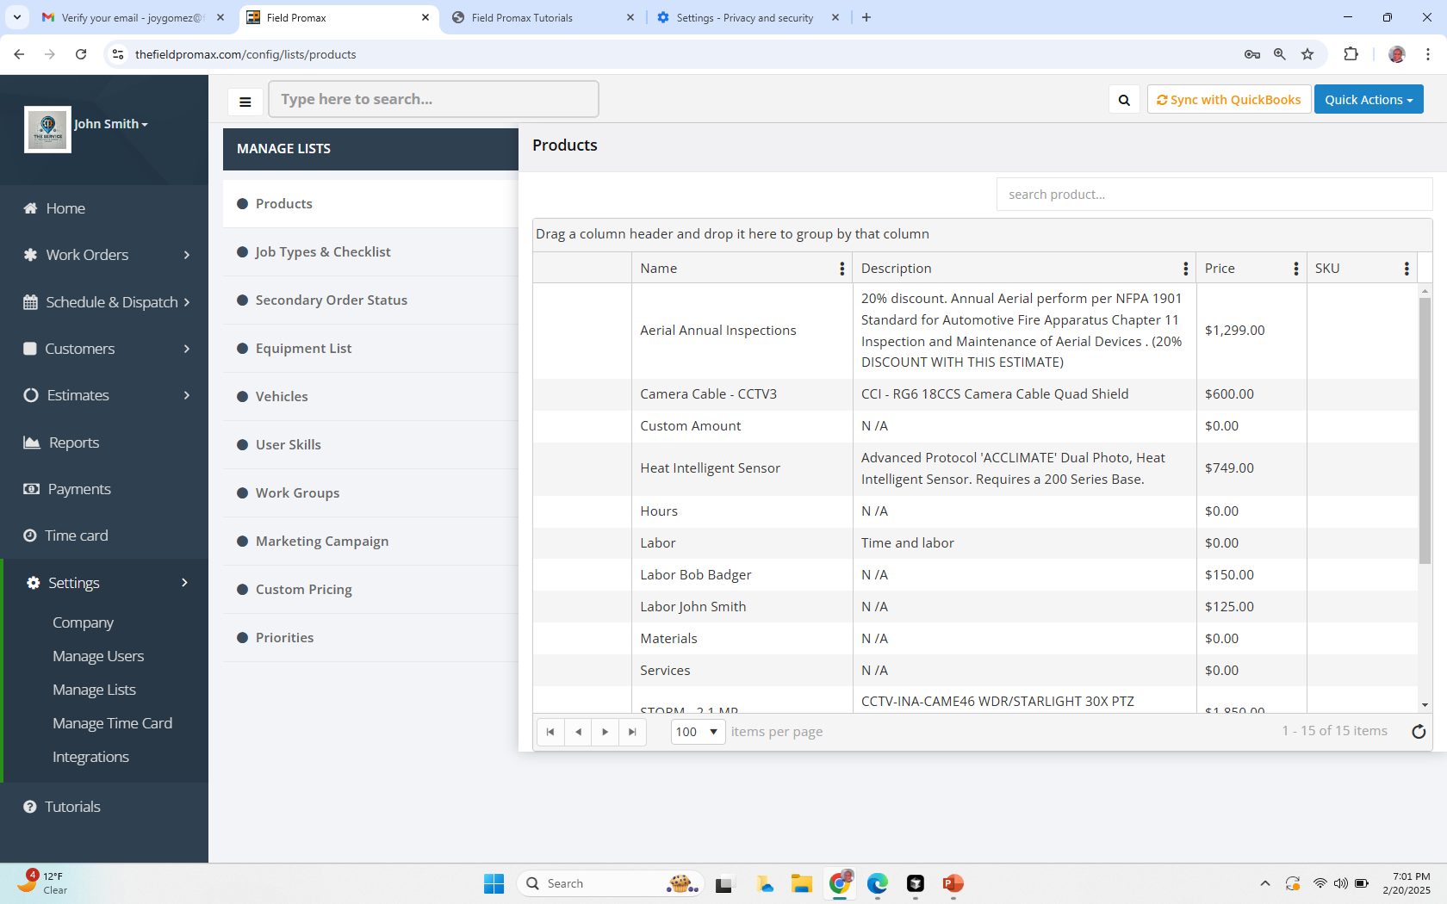
Manage Lists

Slide 5
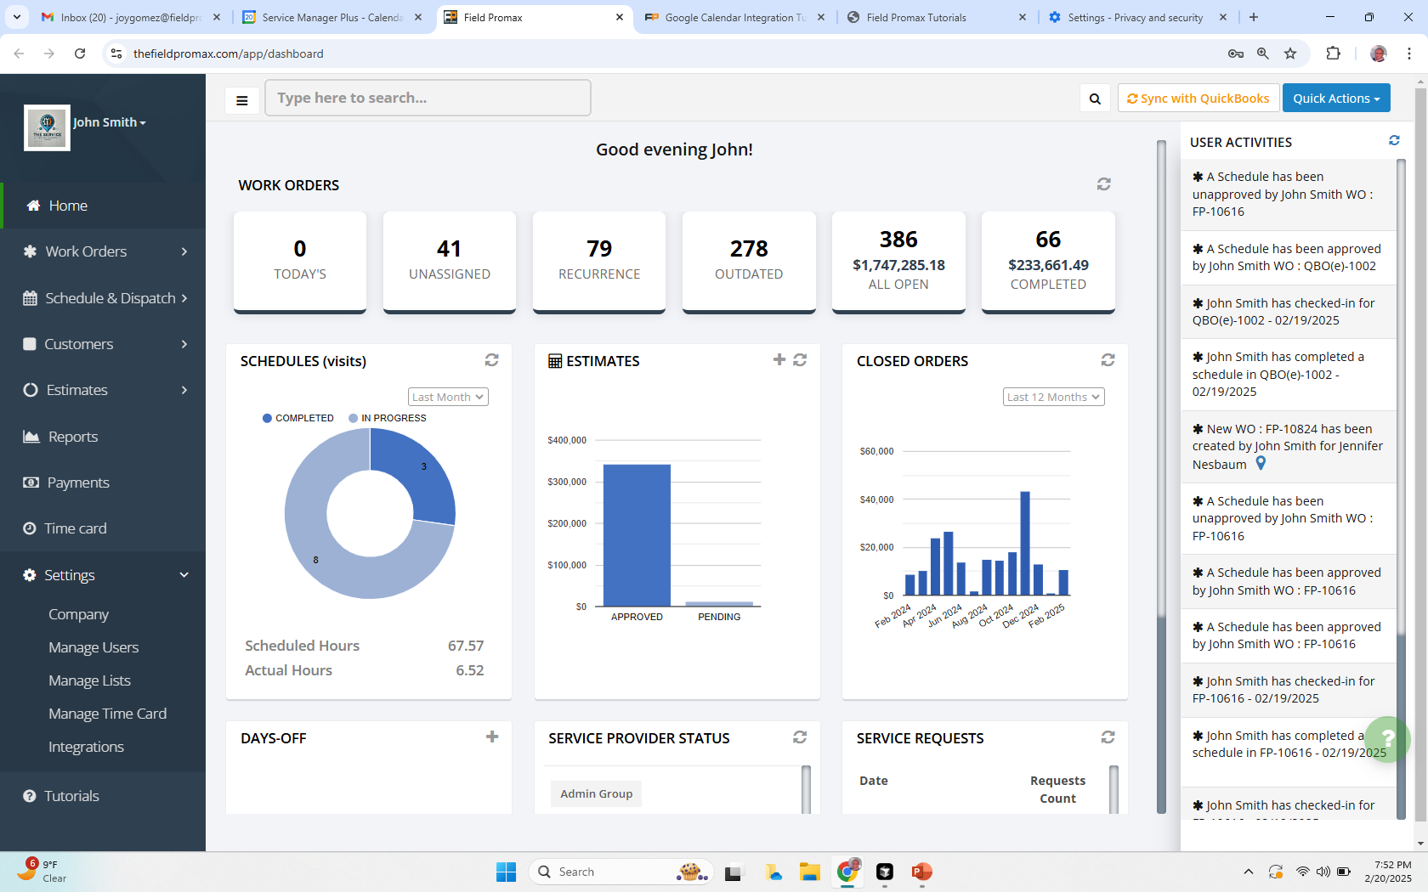


Slide 6
Integrations – Sync with QuickBooks Desktop
Put the video from existing tutorials

Slide 7
Integrations – Google Calendar
Put all the images from the current tutorials

